Slide 1
EPA Alumni Overview HCP Presentation 2021
These are notes for presenters – do not show
This set contains more pages than most will need
Includes two start pages starting at 1900 or 1950s (choice depends on time, audience, your preference) You may also want to adapt, add other materials, drop some progress elements altogether as needed
  The standard version shown here starts at 1950s – Alternative start at 1900s appears at the end- more for APES, longer presentation times
  Optional Info on the HCP reports and Teachers guide at the end
You may want a slide about you (example is JB). Either way start with a brief bit about why you chose an environmental career
Check presenter view in this deck for suggestions about points to make on slides with few words.
Don’t be fooled by gibberish text – use slideshow to reveal animations

Slide 2
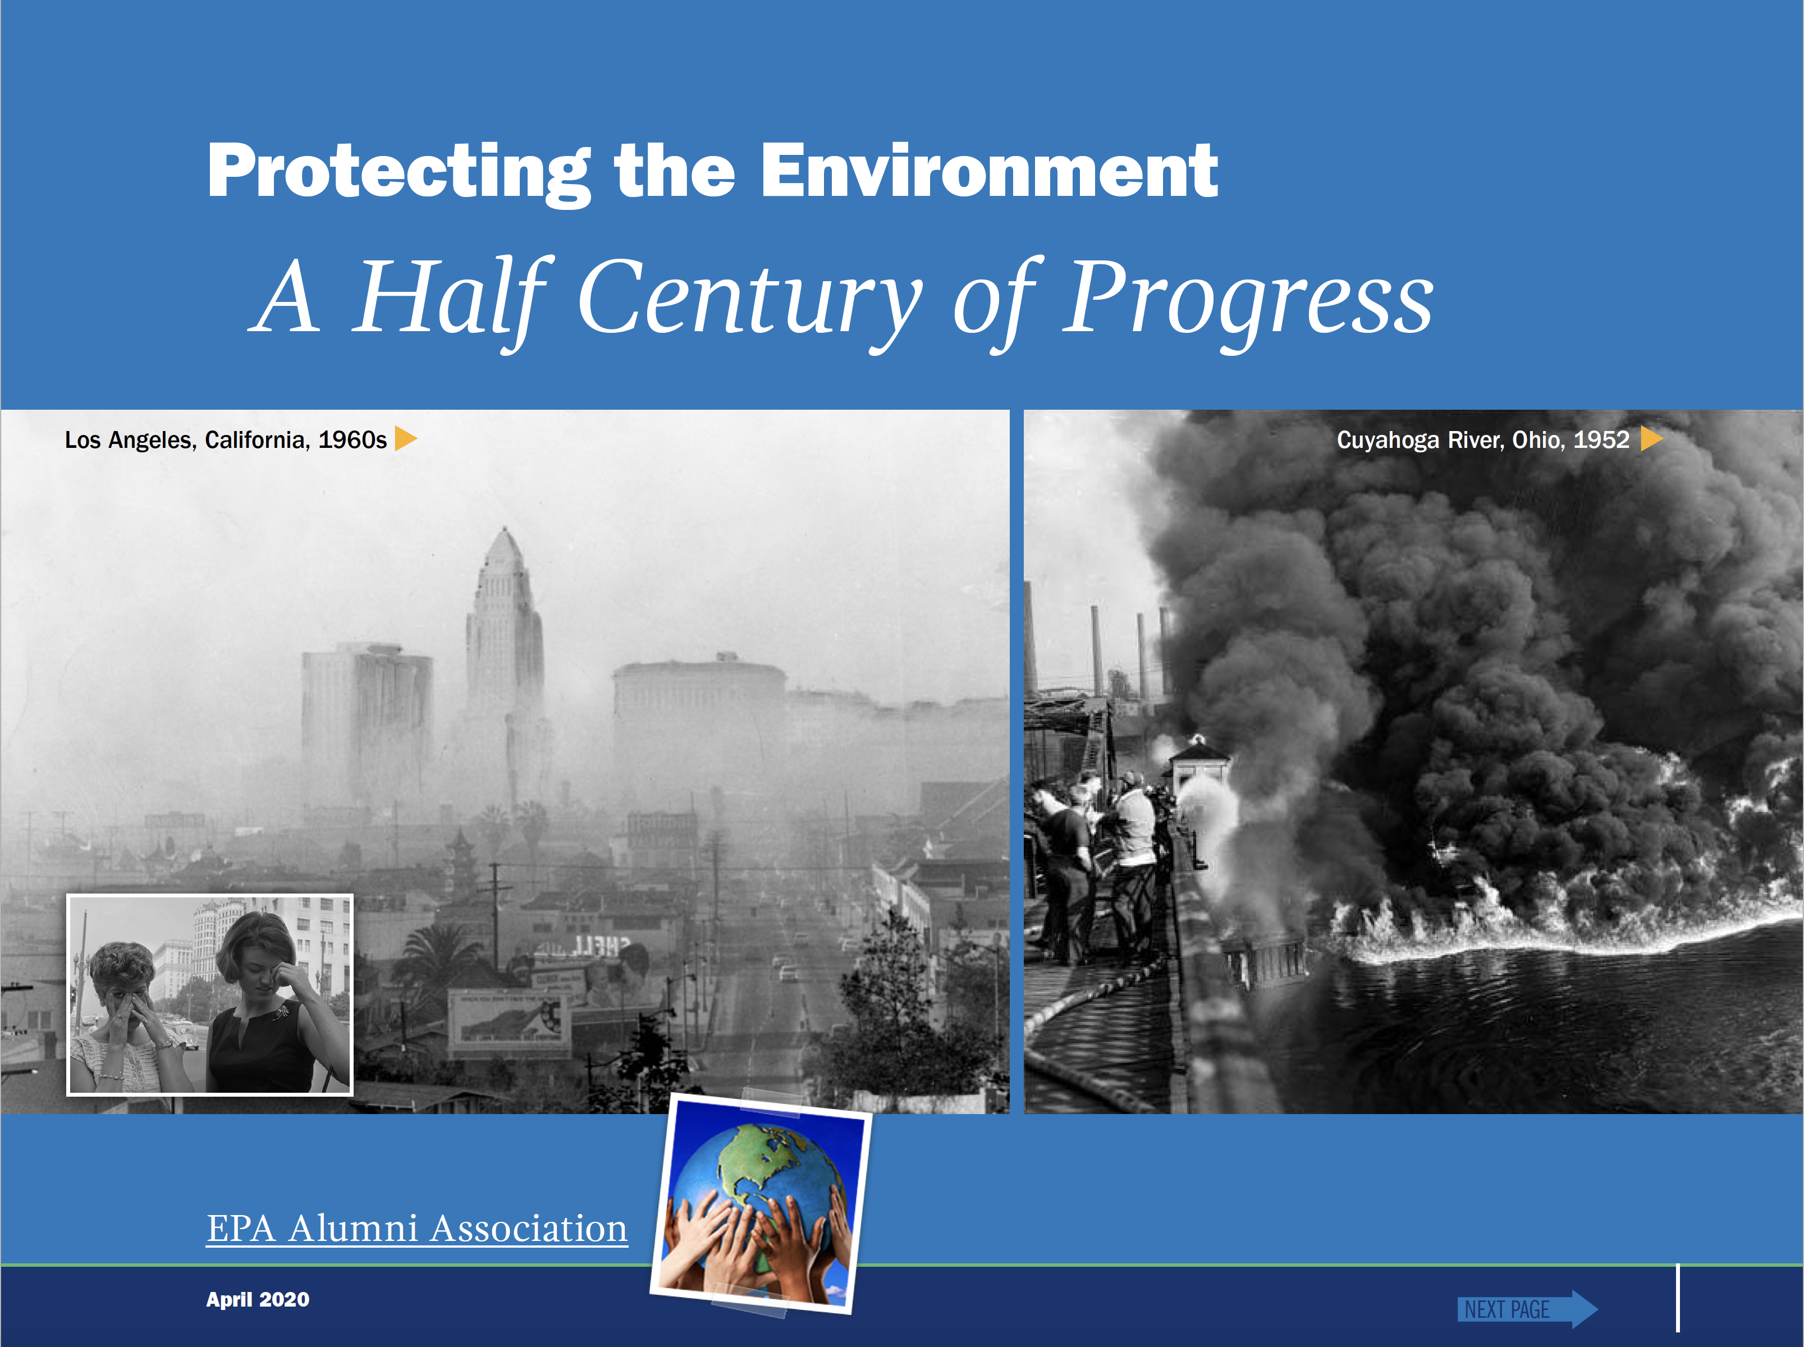
John Bachmann
Notes:
You can create a new cover page, or add your name to this one. If you have a new cover page, note that our message here is distilled from newly updated documents you can look at on the web. Don’t spend much time on it.
The EPA Alumni Association Half Century of progress
- begun late 2014
to inform students and others about the major environmental issues confronting the US in 1960’s and progress made since plus and new challenges over the last 50 years
First reports released 2016 by 21 former EPA experts in 7 specific areas
Major updates available soon on EPA alumni HCP Website.
We also have a teachers guide with Q and A, lesson plans and more (You can let the teacher know beforehand)

Slide 3
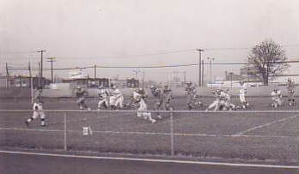
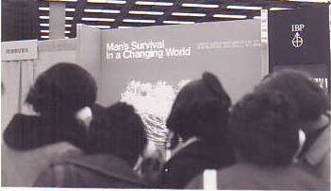
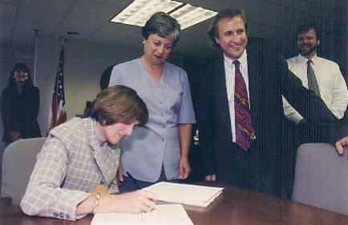
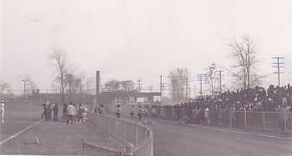
How Earth Day changed my path
Southwestern H.S. 1969
1st Earth Day 1970 , Detroit
1997 Carol Browner signs first PM_{2.5} rule
Notes:
This placeholder slide should be omitted or replaced with an illustration of your personal story on why you chose to work at EPA and/or something about your career – again, with or without a slide. If you have an earth day story, you could move that later in the presentation when we bring up earth day.
You should give a short bio to the teacher ahead of time so they can give students a sense of who’s coming to speak and what you’re going cover. This, before she asks them to each write a question or two to give you in advance for the Q and A.

Slide 4
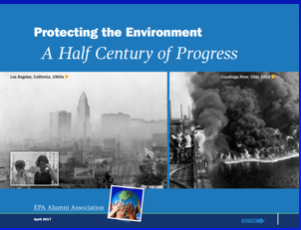
Overview of U.S. Environmental Programs
1950s to 1960s – increasing public health and environmental damage - e.g. smog and river fires
1960s to 1970s – a growing awareness led to Earth Day, EPA and governmental action
1970s to today – a half century of progress
Today – we’re not done with clean up and maintaining benefits, new challenges, climate
Notes:
What you’re going to tell them….if you drop the early slides 1900 to 1950s in your presentation, use this one and refer back to the cover shots on the front page

Slide 5
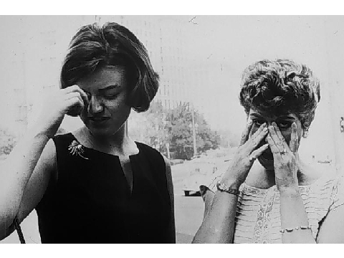
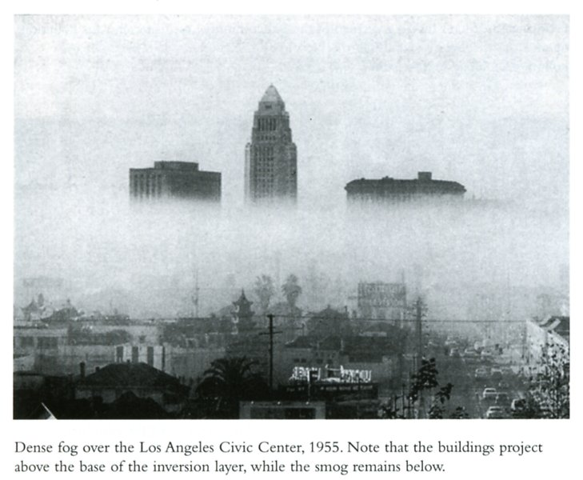
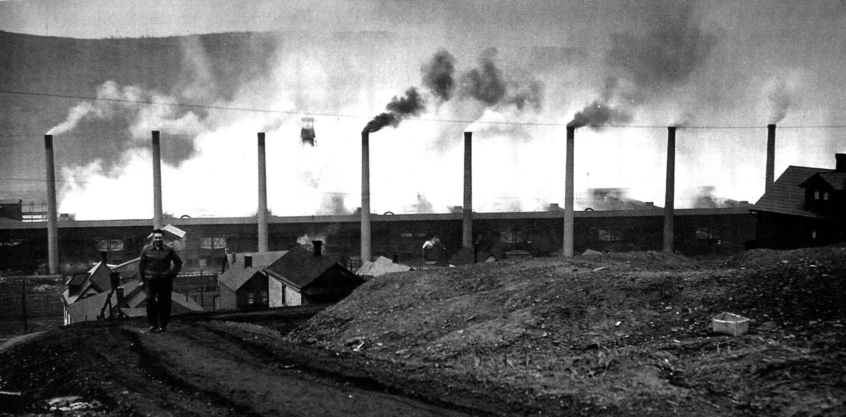
A tale of two cities
In 1943 L.A., an eye-burning ‘smog’ event heralded a new and growing form of air pollution in sunny, healthy southern California
In 1948, an episode in the small town (13,000) of Donora left 20 dead, 6000 sick
These widely reported developments made transformed air pollution into a national problem
Donora PA 1948
Los Angeles 1943-55

Slide 6
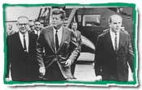
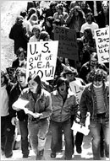
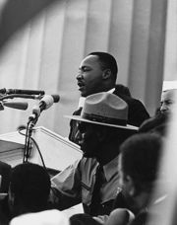
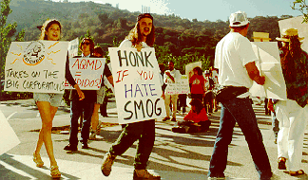
The 1960’s – an era of major change

Slide 7

1960s: A growing environmental consciousness
“Only within the moment of time represented by the present century has one species -- man -- acquired significant power to alter the nature of the world. ”
Notes:
The 1960’s- events lead to growing national environmental awareness, culminating in demands for action
First 1962 publication of Rachel Carson’s book, Silent Spring,
She focused attention to pesticide effects on birds, more
Highlighted information on bioaccumulation of these persistent organic chemicals and their lasting effects far from application.
CBS Special on the book

Slide 8
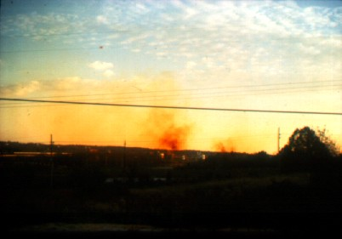
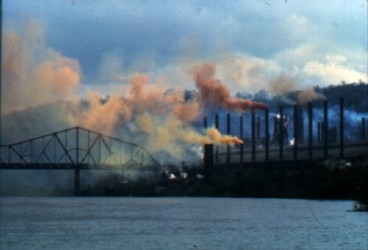
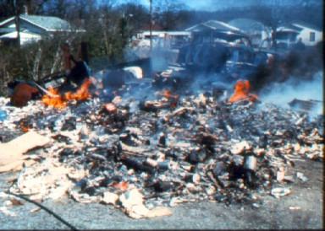
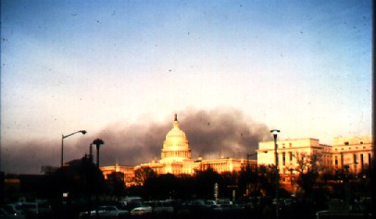
Bad scenes from the 60’s
Chattanooga munitions plant NOx
Steubenville Steel Mill
Burning dump
DC - Down in the dumps
Notes:
– some colors from the 60s - The NY thanksgiving episode was an unnatural disaster
Increasing environmental consciousness
begun by Rachel Carson's silent spring
Popular culture - Apollo picture of earth from the moon
\

Slide 9
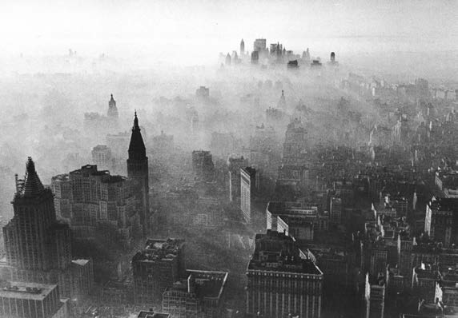
Unnatural Disasters
New York City 1966
Notes:
First of several notable unnatural disasters in the 1960s
The early-mid 1960s saw repeated air pollution episodes in NYC, Birmingham, and more.
Officials in NYC documented 170 “excess” deaths during this Thanksgiving 1966 episode in NYC.
NYC Study: estimated 10,000 excess deaths/year from air pollution from 1963 to 68

Slide 10
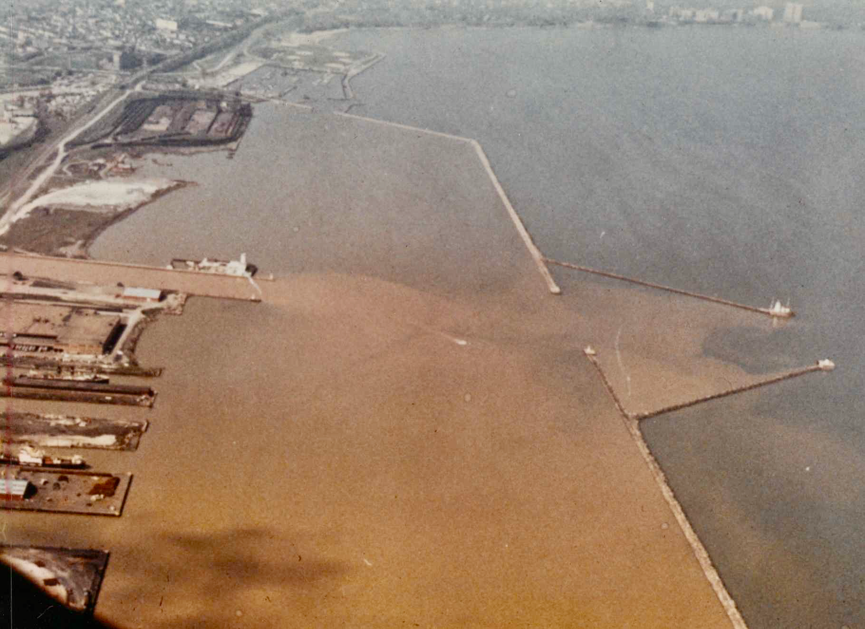
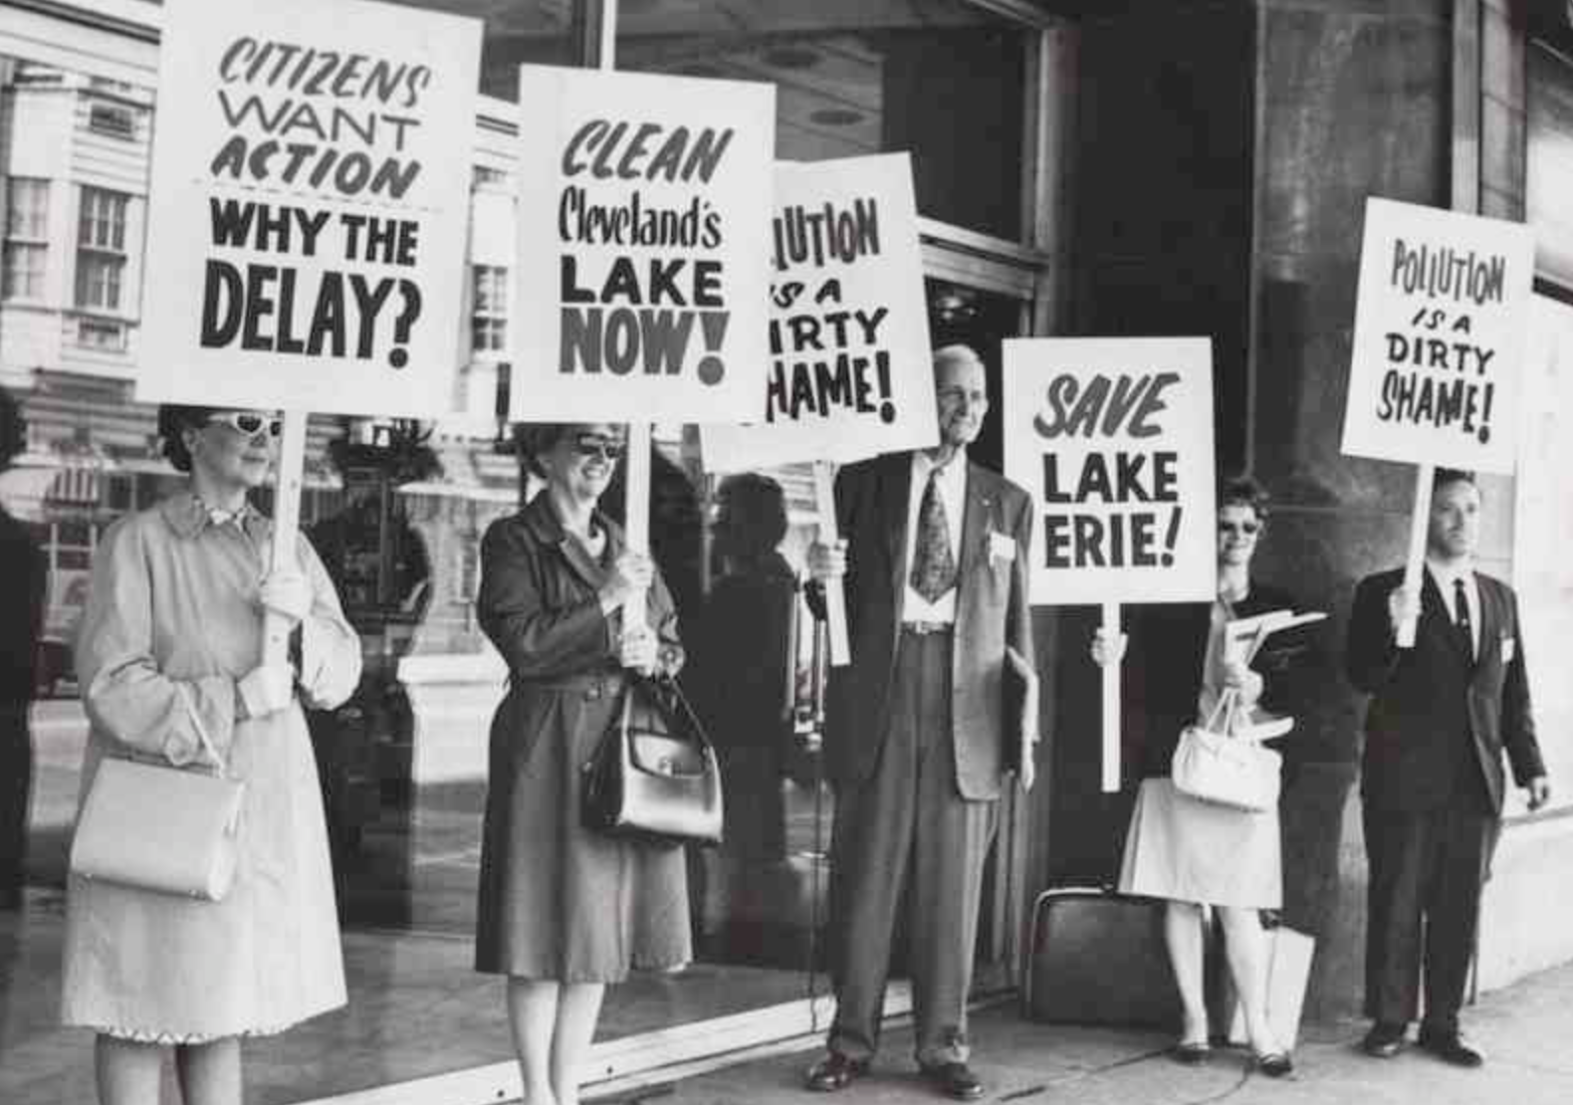
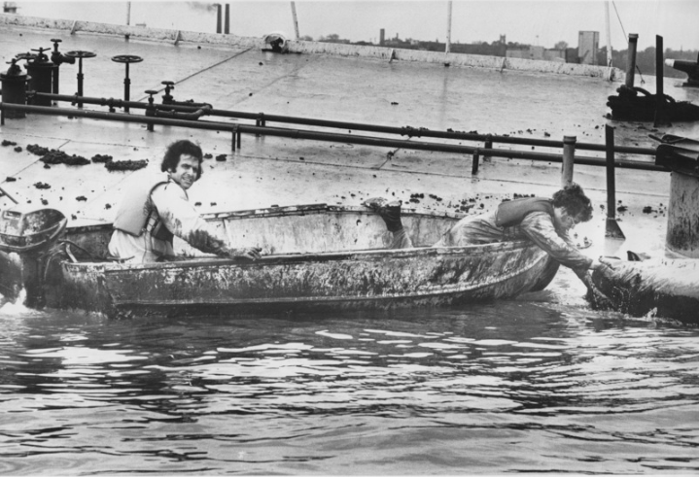
Burn on, big river
The Death of Lake Erie -1968
Notes:
Photo- pollution from Cleveland’s Cuyahoga river (left middle) where it enters Lake Erie
Nutrient pollution - algae blooms and widespread fish kills in Lake Erie
Erie officially declared “dead” in 1968. Click
Public and press expressed widespread concern (these folks don’t look like most images of 1960s protesters) Click
In 1969 the Cuyahoga river actually caught fire – AGAIN!..
Photo - 1952 river fire, one of 12 from the early 1900s to 1969
Oil refineries, others used the river as a sewer for decades Click
oily slime on the surface.
The 1969 fire and Erie Death received major national attention.

Slide 11
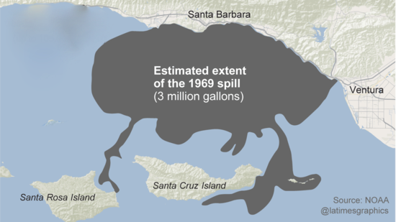
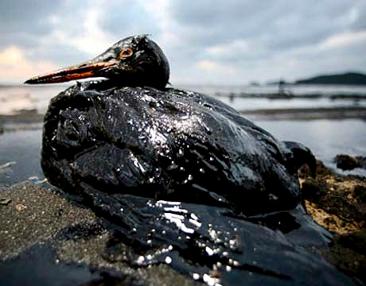
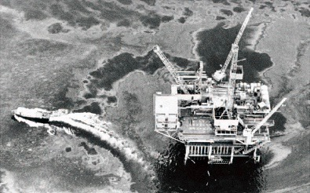
The Santa Barbara Oil Spill-1969
Notes:
The 1969 blowout of an off shore oil well - Santa Barbara, CA, Click
released 80–100,000 barrels of crude oil, Click
The incident killed an estimated 3,500 seabirds as well as dolphins, seals, and sea lions.
The largest oil spill in US waters
Received widespread attention and added to the public concern over environmental pollution.
Back up (FYI, the Santa Barbara Spill is now number 3 third
1989 Exxon Valedz tanker spill in Alaska – 260,000 barrels of oil - 2010 Deep Water Horizon oil well release in the Gulf of Mexico. – 4.9 million barrels of oil)

Slide 12


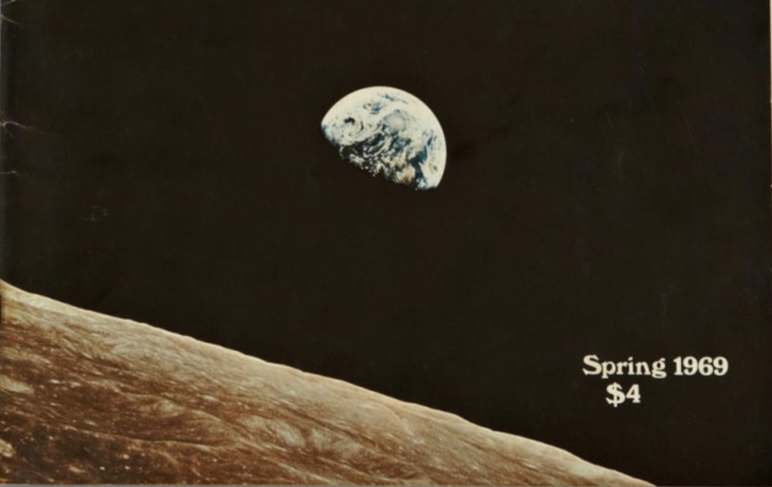
Meanwhile, from a distance…
Welcome! Sulfur dioxide
Hello! Carbon monoxide
The air, the air Is everywhere
Breath deep, while you sleep
Breath deep
Notes:
Left: This iconic picture of earthrise over the moon taken by Apollo astronauts gave many a new perspective of planet Earth
Right: Concern for the environment also appeared in popular culture through songs like Joni Mitchel’s Pave Paradise (Big Yellow Taxi) and this tune from Hair.

Slide 13
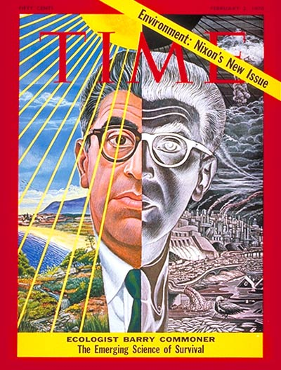
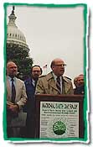
Astute politicians took notice early
Gaylord Nelson – Earth Day 1995 recalling his 1969 inspiration for the first Earth Day, a national “Teach-in” on the environment
February 2, 1970
Notes:
Senator Gaylord Nelson promoted the first Earth Day as a national Teach-In and many new environmental activists responded
Time magazine put an ecologist on its cover
And highlighted the expanding political interest of President Nixon and others in the environment..

Slide 14
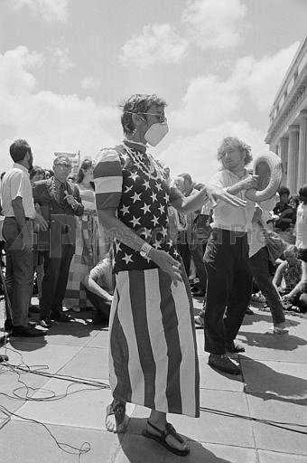
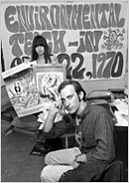
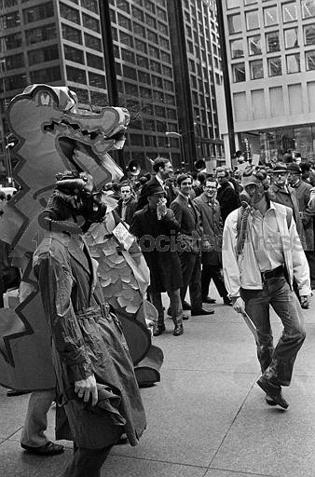
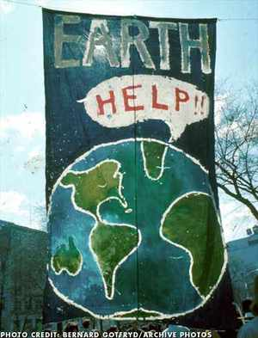
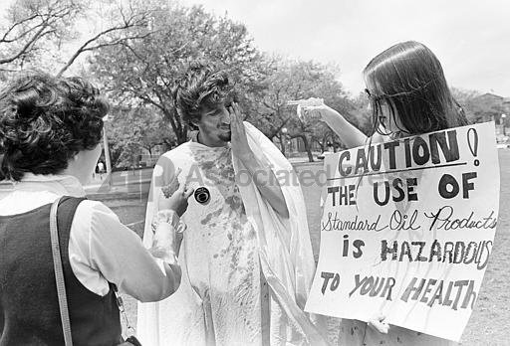
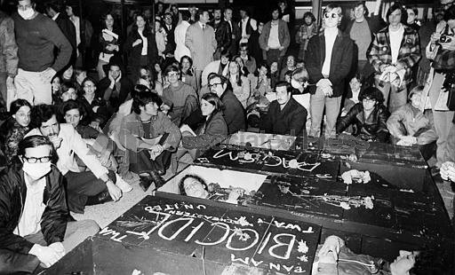
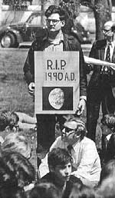
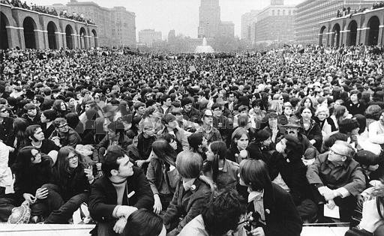
Earth Day April 22, 1970
20 million people participated in a national teach-in
Chicago
New Orleans
DC
New York
Miami
Boston
Philadelphia
Notes:
We’ve seen some big marches this year, but nationally and globally, none reached the participation in the first Earth Day
Politicians took even more notice!

Slide 15
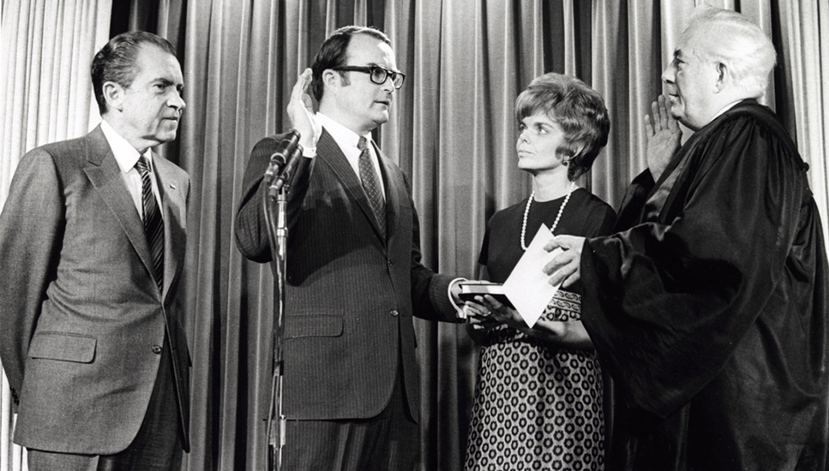
In 1963, 65, 67 new air pollution legislation, research and funding
In 1970 alone:
  National Environmental Policy Act (January 1)
  Environmental Quality Improvement Act (April 3)
  Environmental Protection Agency formed (Dec 2)
  Clean Air Act Amendments of 1970 (Dec 31)
Beginning in the 1960s, federal, state, and local governments took concerted actions, enacting and implementing legislation that created strong regulatory programs to clean up the environment, protect public health and welfare, and prevent further degradation.
Notes:
Use the bullets as talking points, clicking to reveal them as needed and once more at the end to show the photo .
Photo: swearing in of William Ruckelshaus as the first EPA Administrator on December 4th, 1970.

Slide 16
And then..
Clean Water Act (1972)
Federal Environmental Pesticide Control Act (1972)
Safe Drinking Water Act (1974)
Resource Conservation and Recovery Act (1976)
Toxics Substances Control Act (1976)
Superfund (CERCLA, 1980)
These laws required major reorganizations and investments in people and resources by Federal and state/local governments, industries, and more
Notes:
Click to end, don’t name them all
The push to modernize environmental legislation in all areas continued through the next decade.
Italics –THIS IS A CRITICAL POINT TO Make these laws spurred enormous changes in the early 70’s, continuing.
e.g. at the beginning of the 1960s, only 6 states had air pollution programs – by the end of 1970, all 50 did.
In sum, an amazing and large transformation took place in that decade. And scientific research and monitoring found new problems like acid rain and stratospheric ozone depletion during this period.
Background - The laws required major reorganization and new hires in policy, engineering, science, and law to create EPA, who had to start issuing clean air act rules two months after the Agency was created.
States had to play catch up with new hires and programs to address their role in administering these new laws (see next slide), e.g. at the beginning of the 1960s, only 6 states had air pollution programs – by the end of 1970, all 50 did.
Industry also had to hire new engineers, scientists (and lawyers) and, in the case of automobiles, develop new technologies and to address new requirements for all media programs.
Each law created more requirements for implementation as well as monitoring, and enforcement. As a result, many new people came into the business of environmental protection and old hands had to adapt. Air, water resources, drinking water, pesticide assessment and regulation, waste, and addressing pesticides and 10’s of thousands of other potentially toxic chemicals in commerce.

Slide 17
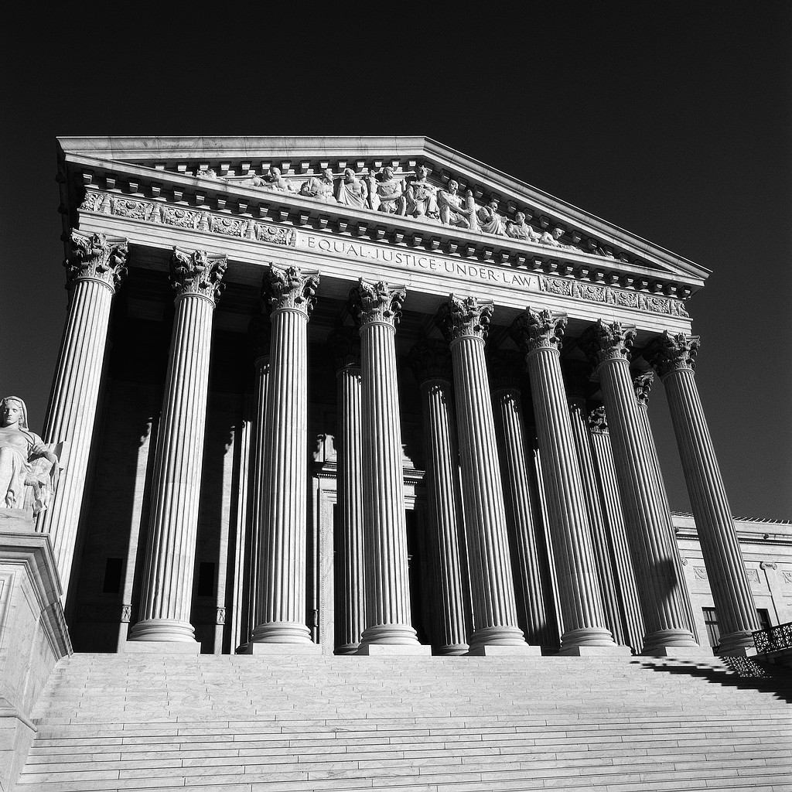
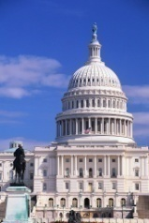
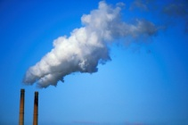

Key players in EPA Programs
The executive Branch
The Courts
EPA CEQ OMB
Congress
Other Federal Agencies
DOE, DOC, DOT, DOI,,USDA
DOD, NOAA, NASA,
Major Industry,
Trade organizations
EPA Programs
Other Nations
Small Businesses
Agriculture
Scientists, engineers, academia, research organizations, NAS
Clean Air Scientific Advisory Committee (CASAC), Science Advisory Board
State Governors
County Officials
Mayors
City Council Members
State Legislators
The public at large
  Educated/environmentally interested
  Consumers, Students
State/Tribe/Local Air Agencies
Environmental and Public Health Groups
EPA Regional Offices
Notes:
This illustrates the italic points – most of these were not major players before the 60s-70. Does this revolution contain a lesson for the even larger problems we face today?

Slide 18
How are these laws implemented?
EPA sets national goals
States, local agencies and tribes design and implement programs for many programs
EPA responsible for pesticides, new chemicals
Notes:
Use the main bullets -not the second level
EPA has a central role, but not just EPA
States, Local county/city agencies, Tribes, regulated sources, and the public all have a role in in improving air, water, drinking water, waste
EPA does Pesticides and toxic chemicals, but industry has responsibilities as well

Slide 19
Air Quality Management - 1970
Establish Goals
Determine Emissions Reductions
States monitor, inventories, model reduction strategies
EPA sets science-based national standards (NAAQS)
Develop Programs to achieve
Track and Evaluate Results
Scientific Research
States develop implementation plans.
EPA reviews plans.
EPA sets technology-based national standards for vehicles, new major stationary sources, more
States monitor to see if standards are achieved
Implement and Enforce Strategies
The US approach is a Hybrid!
Sources comply with rules
States and EPA enforce
Notes:
Three ways to do this one - the full version has you spending time on each box. If you eliminate the animation but keep the language below each box, you might save a bit of time, but just showing the box without the underbox details is faster.

Slide 20
These programs have dramatically improved the environment, resulting in significant commercial and recreational benefits. They have also greatly enhanced protection of public health.
Notes:
Paraphrase the text above and click
Let’s look at some of these improvements, starting with the Air programs under the Clean Air Act –

Slide 21
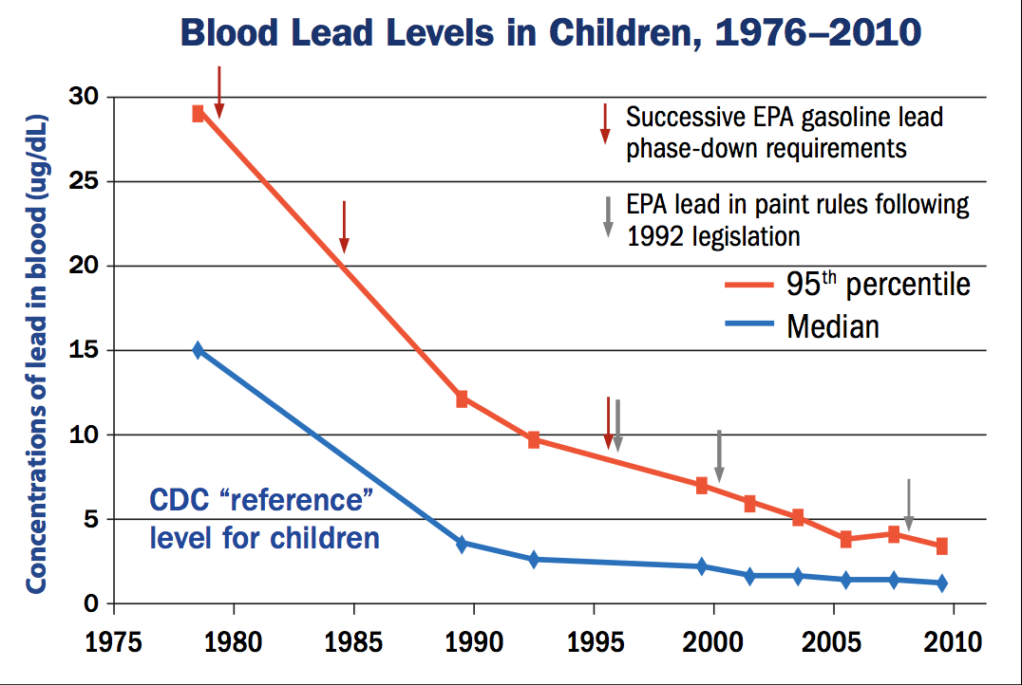
Notes:
Note - most exposed (95th%tiles) vs. Median
The arrows show EPA gas and paint rules
MAJOR DECREASE IN BLOOD LEAD LEVELS IN CHILDREN BEGUN BY SUCCESSIVE EPA REGULATIONS TO REDUCE LEAD IN GASOLINE (Clean Air Act)
CONTINUED BY EPA RULES THAT REDUCED LEAD IN PAINT (TSCA).
Infants and young children are especially sensitive to even low levels of lead, which may contribute to behavioral problems, learning deficits and lowered IQ.

Slide 22
Los Angeles Smog levels
Days above 2008 Ozone standard (0.75 ppm)*
Maximum 8-hour ozone concentration trend
Notes:
LA had the worst photochemical smog in the nation, but tremendous progress due to-.
The introduction of automotive catalysts in new cars (‘76 on)
Continuous actions taken by California and the South Coast Air Basin over decades
California rules and amendments to the Clean Air Act (1977, 1990) , new EPA regs resulted in tighter car and truck emissions limits nationwide

Slide 23
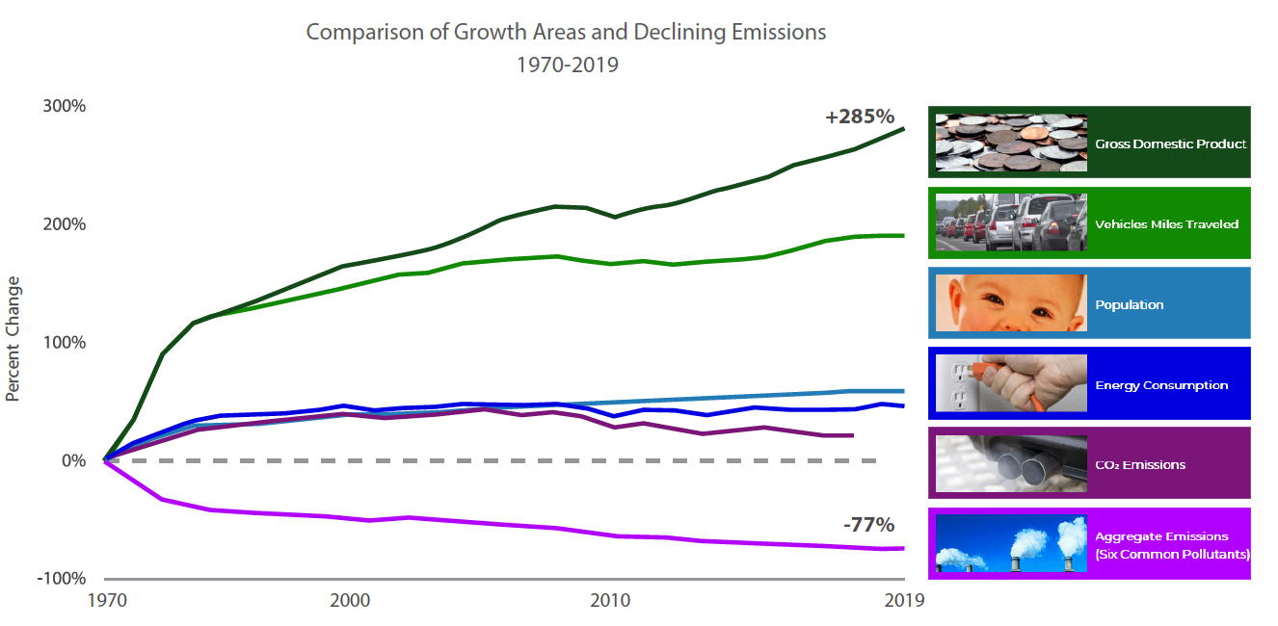
A Clean Air Success Story – benefits, costs, and growth
Cumulative benefits 1970-90
$6 to $50 trillion
Cumulative costs - $ 520 billion
Projected annual benefits 2020
$2 trillion/yr
Annual costs - $65 billion/yr
Notes:
Since 1970, emissions of regulated pollutants (purple line) have declined by 77% despite continued growth in population, energy consumption, traffic, and the economy.
By contrast, CO₂, not targeted by CAA programs until 2012, followed trends in energy consumption and traffic starting a slow reduction from decreased use of coal.
CO₂ increased by about 4% in 2018 over 2017
EPA Reports to Congress Retrospective benefits (1970-1970) (1997) Prospective benefits 1990=2020 (1999 and 2011)– Bottom lines:
Monetized benefits of EPA regulations greatly exceed costs
Continuing challenges – not all areas meet standards in the US, air pollution is a major issue in Asia and other developing areas, the failure to address climate change in the US, + withdrawal from the Paris accords

Slide 24
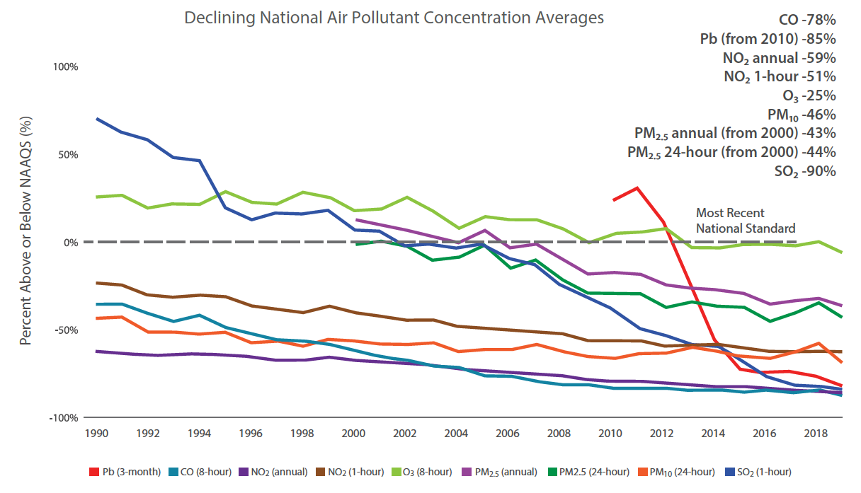
Major pollutants continue to decrease
But….
10s of thousands of premature deaths/yr remain in the US
Standards should be strengthened
Climate
8-hr Ozone trends
Environmental justice – minorities 75% more likely to live near oil and gas facilities, chemical plants
PM_{2.5} annual
PM_{2.5} daily

Slide 25
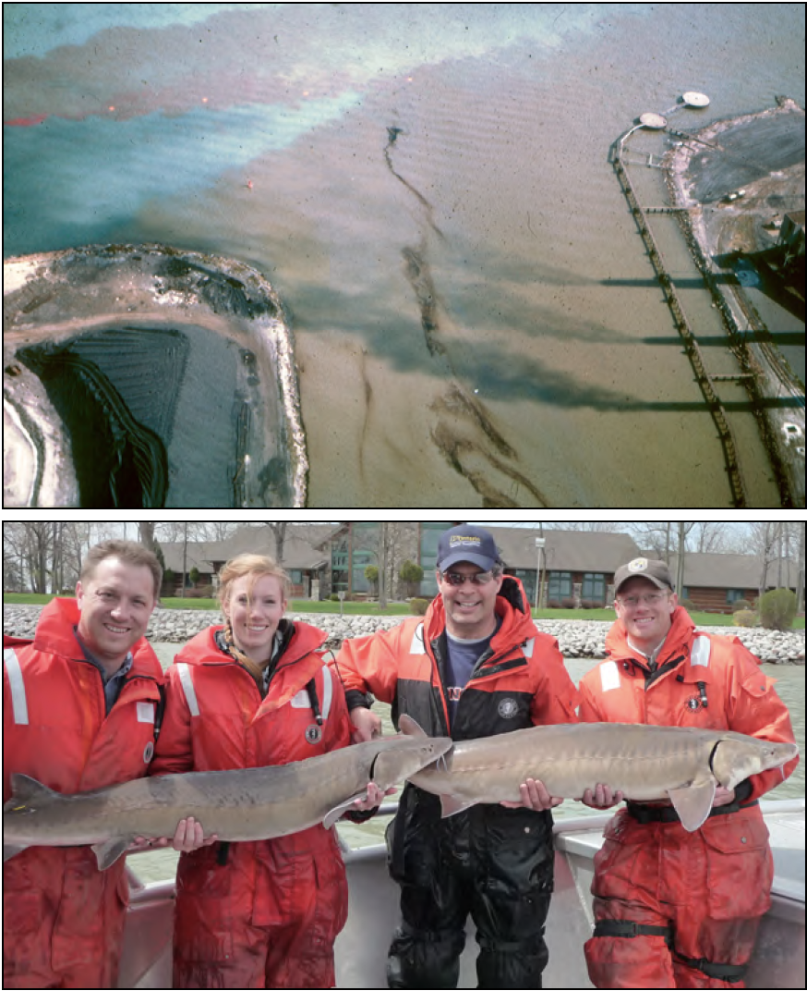
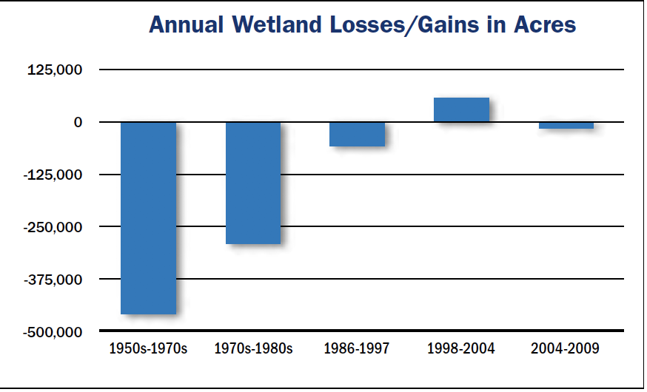
Clean Water Act programs
1966
Today
Notes:
Recovery of the Detroit river –
Top: the Rouge river delivered waste to the Detroit river, devoid of fish in 1966.
Bottom: large sturgeons and other fish have returned to the river Click.
The annual loss of wetlands has slowed by 96% from the rates of the 1970s and '80s
Click to see improvement in sewage treatment for most Americans – not including septic systems
Continuing challenges - new persistent chemicals (e.g. PFAS) and non-point source nutrient loadings to Great Lakes and estuaries, and climate change - sea level rise, ocean warming, acidification
Optional details
Clean Water regulations greatly reduced pollution discharges - dramatic improvements in wrt burning rivers, odors, sewage overflows wide spread fish kills.
States wrote discharge permits for 57 industries, contributing to these huge reductions. Stormwater overflows are managed by over 200,000 discharge permits for municipal and industrial sources.
EPA provided $190 billion for municipal treatment wastewater treatment systems, today far more people served by more advanced treatment systems

Slide 26
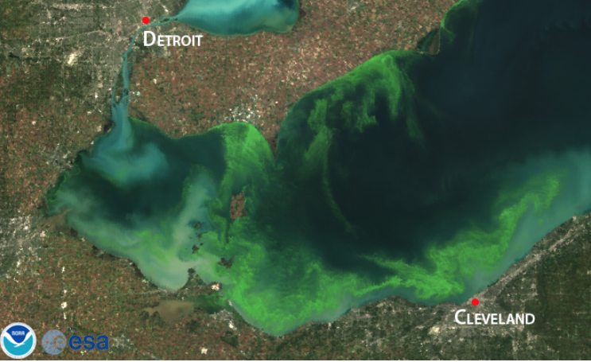
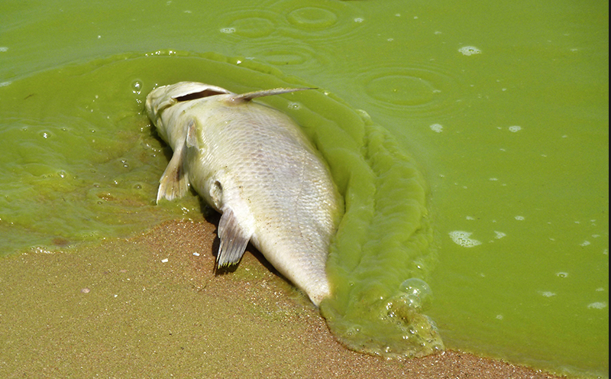
Continuing Water Issue: Nutrient loadings
Notes:
We declared victory on Lake Erie by the 1980’s – no more burning rivers, industrial wasts way down, the ‘dead zone’ almost gone
But in recent years nutrient loadings have increased - and the bottom of much of the great lakes is covered with the invasive “Zebra Mussel”

Slide 27
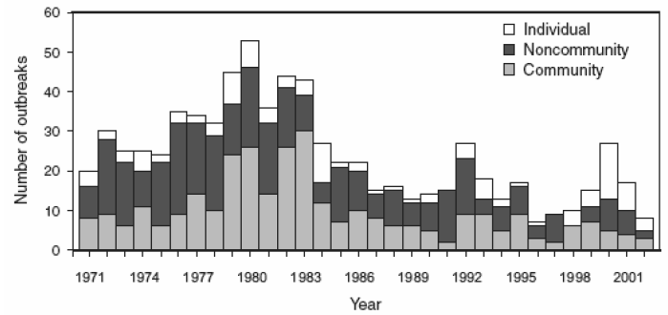
Drinking Water
Number of drinking water disease outbreaks 1971–2002.
Notes:
Reduced disease outbreaks in community water systems
1969 survey: over half of US water treatment systems had major deficiencies
1974 drinking water act pushed modern controls on water supplies for cities
Focus: trends for disease outbreaks in community water systems starting 1975
This took time: Community outbreaks finally began to decrease in early 1980s
% of Americans with DW meeting all EPA standards:
1993 79%
2015 91%.
Continuing challenges:
major degradation in water treatment infrastructure,
Risks from certain bacteria e.g. Legionella, and persistent PFAS
increasing supply in water short areas (desalinization, reuse of treated waste-water)

Slide 28
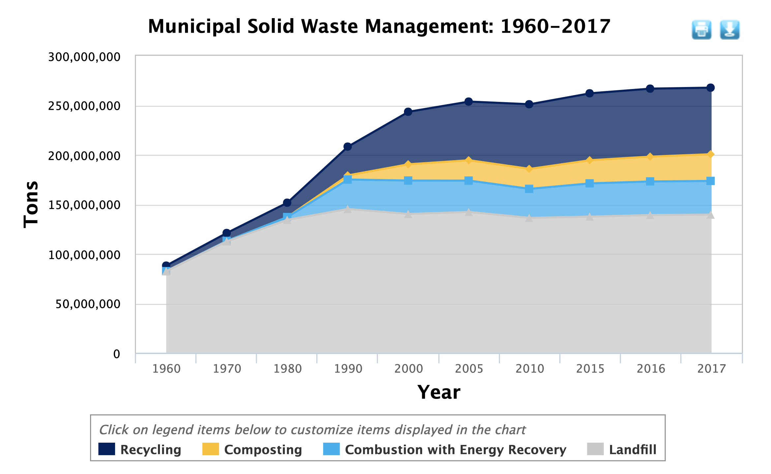
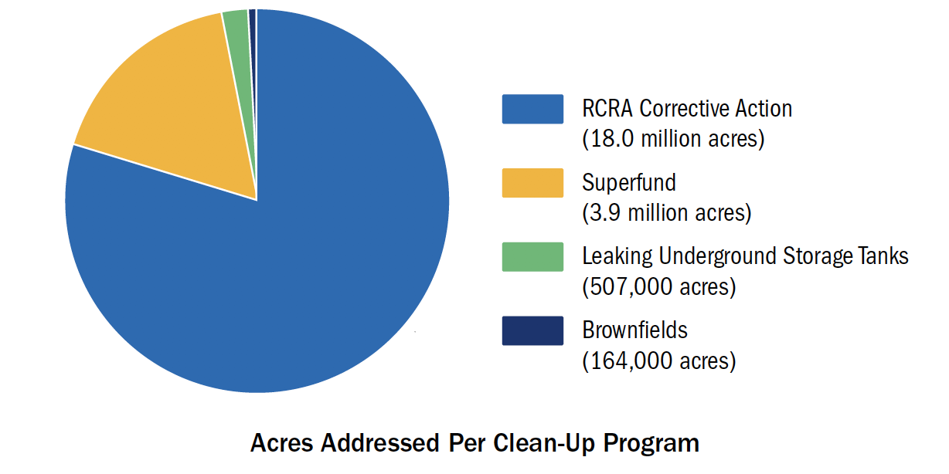
Managing Solid Waste
Notes:
Stopping the dramatic increase in Total annual US Municipal Solid Waste.
EPA RCRA Programs: Reduce generation of waste at the source, recycling, reuse and combustion
Better sealing of landfills to reduce release, energy recovery by burning of landfill gases (methane and organic chemicals)
RCRA also reduced the generation of hazardous wastes from industry.– but not enough – next page
Continuing Challenges – Total generation slowed, but not stopped.
Recycling some materials, PLASTICS!, is under serious stress - China is rejecting our waste.
Greater effort to minimize waste creation.
Other issues include new chemicals (e.g. PFAS) and nanotechnology product that are increasing in the waste stream.

Slide 29
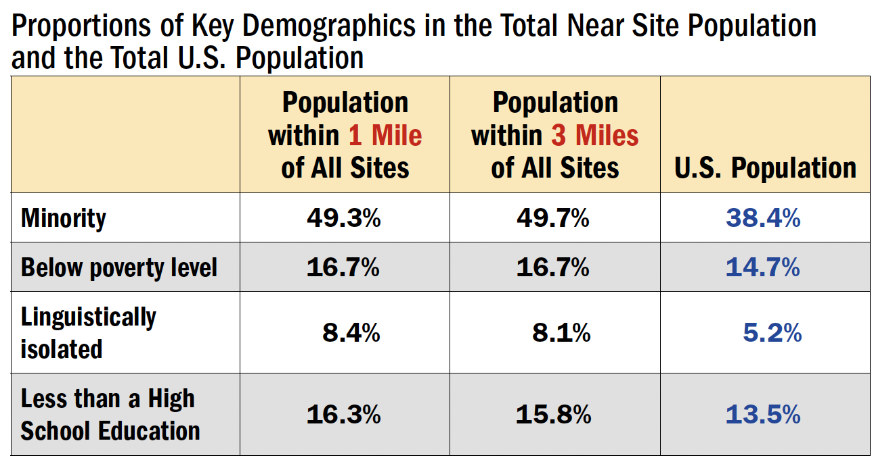
Superfund
Over 1700 sites in the Original Superfund list
  Of those not deleted from the list, 1526 had eliminated unacceptable human exposures as of 2018
  163 have insufficient data
  123 are not yet under control to acceptable risk levels
  A total of 529 sites have been returned to productive use
“Valley of the Drums” near Louisville, 1981.
Notes:
Bad examples - Love Canal in Niagra Falls NY and the ”Valley of the Drums” shown here led to the Superfund law. Click Click
Superfund: EPA provided funds to identify, assess, and remedy risks by Click stabilizing and ultimately cleaning up sites. Click
Follow the slide bullets
Continuing challenges – completing the existing clean ups, returning site land to a state where they can be used for other purposes
Last table highlights environmental justice issue for superfund site locations.
Additional info from EPA’s 2018 report lists the following significant public health and economic benefits
20-25% reductions in birth defects among children living near sites
Reductions in blood lead among children near sites
19-24% increase in residential property values within 3 miles of the site after cleanup
1980: 80% of US lived within 3 miles of one of 60,000 facilities generating 20-40 million tons of hazardous waste each year,

Slide 30

Pesticides
Ad in Time Magazine, 1947.
Notes:
DDT was once lauded as safe and productive Click
EPA banned DDT in 1972 reducing residues (DDE) that weakened bird eggs, leading to recovery of bald eagle, brown pelican, and peregrine falcon populations in the US
Pesticide law (FIFRA) required review of the safety of existing and new pesticides.
Led to removal of some risky pesticides and discontinuation of thousands by manufacturers.
EPA Review of 10,00 limits for pesticide residues on food (1996 Food Quality law) removal of many of the more toxic products from the market.
Continuing challenges – understanding the role of pesticides in declines of butterflies, honeybees, frogs and other species. Assessing implications of new nanotechnology in pesticides. Assessing effects of pesticides on endocrine systems in humans

Slide 31



Toxic Substances
Key Examples
  PCBs
  CFCs
  Asbestos
  Lead
  Mercury
Toxics Release Inventory (TRI)
Notes:
1970s News reports highlighted concerns about Toxic chemicals like these Click
Thousands of new chemicals were being released - little knowledge of their health or environmental effects.
1976 TSCA authorized EPA to gather information on and require testing of chemicals.
EPA – new inventory of existing chemicals, industry must notify EPA of new chemicals. Click
1984 -85 Deadly releases of chemicals in Bhoupal & West Va prompted:
a 1986 law for emergency planning, right to know Click .
EPA TRI - you can search for releases near you.
TSCA was amended to address asbestos in schools, lead in paint, and significant update in 2016.
Results: 2,000+ new chemicals not commercialized in US.
EPA imposed measures or testing for more than 3,000 more chemicals that were allowed into commerce.
EPA shares testing reports and studies on chemical hazards and exposure; extensive information on how chemicals are produced, distributed and used in society
Continuing challenges – Much work remains to follow through on the new mandates from 2016 legislation, particularly for a series of existing chemicals, but also many new chemicals, including some using nano or other new technology .

Slide 32

1987 Global Agreement to restore Stratospheric Ozone UV Protection
Notes:
1974 – science found long-lived Chlorofluorocarbons (CFC) refrigerants can deplete the stratospheric (good) ozone layer that reduces of harmful UV radiation.
The Figure shows shows normal levels of stratospheric ozone over the South Pole in 1971
By the mid 1980s a dramatic “Ozone Hole” had developed similar to what was observed as recently as 2015.
Spurred by the scientific evidence, nations from around the globe, academics and industry, gathered to negotiate a solution. In 1987, they adopted the Montreal Protocol on Substances that Deplete the Ozone Layer.
Under the Reagan Administration, the U.S. played a strong leadership role in getting other nations to agree.
CFCs are very long-lived, so it takes a long time for reductions to work. Red line shows the immediate result was to stop the problem from continuing to degrade, and more recently to begin improving.
Models show substantial improvements expected to continue for the rest of the century.
This slide is particularly important as it illustrates the kind of interchange between science and policy needed to address a serious global issue – Be sure to make this connection to addressing climate, which will similar reliance on science and global agreements, but is more complex and more serious.

Slide 33




Despite progress, major challenges remain
San Francisco Sept 2020
Continued improvements to maintain and increase the benefits achieved so far, and ensure they are distributed fairly to all Americans
Climate change
  Drought/fires and PM_{2.5} are already here
  Warming increases air pollution, sea level
  rise, ocean acidification, rainfall intensity
  Climate strategies benefit air and water
Los Angeles Oct 2019
Notes:
Short statements about need for addressing continuing past problems (e/g/air pollution, non-point nutrients, environmental justice for all)
Global air pollutant problems with estimates of annual deaths as high as 7 to 9 million per year from Global Burden of disease reports) also emissions circumnavigate the globe degrading US Air Quality
Climate change – two fire shots, the first from LA last year, the second from mid September 2020

Slide 34


Biodiversity and Sustainability
Bleached Coral in the Southern Great Barrier Reef
Climate change contributes to these other global issues and poses direct and indirect threats human health, where and how people can live and work, and more.
Learn from the past – the future isn’t waiting
Deforestation in Indonesia
Notes:
Other major global issues of Biodiversity, Sustainability, and endangered species are causes and effects of climate change
Photo: Burning rainforest in Indonesia to make way for a Palm Oil plantation CLICK
A turtle finds little left in a bleached coral reef – This is at the south of the Great Barrier reef, Earths largest ecosystem CLICK
Note the relationships in the bullet CLICK
Learn from our major accomplishments and failures – we (YOU) are on the clock (or whatever you want to say)

Slide 35
Optional Slides
The first three are an alternate start – they replace the first text slide and the tale of two cities

Slide 36
Key Conclusions
1900s to 1960s – increasing public health and environmental damage
1960s to 1970s – a growing awareness led to Earth Day, EPA and governmental action
1970s to today – a half century of progress
Today – we’re not done with clean up and maintaining benefits, new challenges, climate
Notes:
What you’re going to tell them….if you drop the early slides 1900 to 1950s in your presentation, revise the start date in the first bullet

Slide 37

Strong growth of an industrializing country over nearly two centuries led to increasingly negative effects on our air, water, and land, with accompanying serious effects on people’s health and the environment.
Los Angeles
Donora
Pittsburgh
Notes:
The industrial revolution dramatically changed how society was organized
Rapid urbanization, population growth, big extractive industries and pollution – air/water/waste.
Coal use increased first - for industry and home heating
Post war petroleum marks the growth of automobiles and suburbs and new kinds of pollution. (why a dip in 1930s?)
A tale of 3 cities to explore some of these transformations click 1910 Pittsburgh, click nearby Donora PA in 1948 and click Los Angeles in the 1950s.
A BTU – energy 1lb of water 1 deg.
Quadrillion - 10e15

Slide 38





Pittsburgh 1906-1910
Typhoid Fever death rate
Notes:
Pittsburgh – the smoky city – miserable conditions
City authorities viewed it as a nuisance necessary for the economy, not a public health issue.
Early complaints - women’s groups click
Water supplies for a large crowded cities were polluted by wastes – Here, authorities took action to filter drinking water source - - dramatic reduction in deaths from Typhoid Fever.

Slide 39


Los Angeles 1943-55
Donora PA 1948
Notes:
Donora - Small industrial town 40 miles from Pittsburgh
A typical day in 1948. Click
Donora at NOON during deadly smog
Foggy conditions created extreme episode (smog) of smoke and SO₂ that sickened 6000 people (40% of the population, and 20 died Click
1940’s -50’s LA a new kind of smog later found it was automobile emissions, Photochemical smog included “bad” ozone and other chemicals. Click
This smog irritated the eyes as well as the lungs.
These two events plus 1952 London killer smog
– Air pollution became a public health issue

Slide 40









EPA Alumni Half Century of Progress reports, available https://www.epaalumni.com/hcp

Slide 41
Environmental Careers
  EPA Employs Scientists, Engineers, Lawyers, and Generalists
    14,000 Employees, Washington, Boston, New York, Philadelphia, Atlanta, Dallas, Chicago, Kansas City, Denver, San Francisco, Seattle
  State, Tribal, Local Environmental Agencies (DEQ, DEP, etc.) 60,000 nationwide
  DW & Wastewater Utilities
  Other Federal Agencies: NOAA, Interior, Agriculture, Army, TVA
  Environmental Organizations: National (Sierra Club, EDF), Regional (Chesapeake Bay Foundation) & Local (Friends of the Rappahannock)
  Private Sector: pollution control and monitoring equipment, industrial pollution control, consultants, environmental control and compliance
  Research universities
Notes:
I loved working at EPA. Great colleagues, many challenges, ”can do” attitude. Pay was “OK” but there were many other rewards.
Opportunities to work all around the USA & internationally. I encourage you to consider an environmental career. Most job applicants these days have masters degrees or higher.
1980: 80% of US lived within 3 miles of one of 60,000 facilities generating 20-40 million tons of hazardous waste each year,

Slide 42
EPA Alumni Overview HCP Presentation 2021
Contains more pages than most will need
Includes two start pages starting at 1900 or 1950s (choice depends on time, audience, your preference)
You may want a slide about you (example is JB). Either way start with a brief bit about why you chose an environmental career
Check presenter view in this deck for suggestions about points to make on slides with few words.
Don’t be fooled by gibberish text – use slideshow to reveal animations

